Slide 1


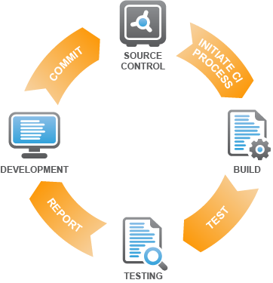

Build Processes and Continuous Integration
Automating Build Processes
High-Quality Code
SoftUni Team
Technical Trainers
http://softuni.bg
Software University

Slide 2

Table of Contents
Source Code Building
Build Processes
Continuous Integration
JetBrains TeamCity

Slide 3

Build Automation

Slide 4
Software Builds
What does it mean to build software?
The process of compiling and assembling the system's modules to obtain the final product
Build activities can also include:
Getting the latest version from the source control repository
Linking external resources
Executing unit tests
Creating installation packages

Slide 5
Build Processes in Visual Studio
You can create custom build processes
Used in continuous integration environments
Contain a set of steps to execute when building the project
Build processes resolve dependencies across projects
Build processes can prevent team members from “breaking the build”
Each commit in the source control repository goes through the build process first
If it fails, it is not sent to the repository
https://msdn.microsoft.com/en-us/library/ms181715.aspx

Slide 6
Creating a Build Definition
Connect Visual Studio’s Team Explorer to a source control system
Open Builds in Team Explorer
Click New Build Definition
Use the UI to create your own build process definition
Specify the steps which will be performed after VS starts to build your project
Specify output file locations
https://msdn.microsoft.com/en-us/library/ms181716.aspx

Slide 7

Continuous Integration
JetBrains TeamCity

Slide 8
Continuous Integration (CI)
Continuous integration (CI)
Automating the build and integration process
Build the entire system each time any new code is checked in the source control repository
Run all the automated tests for each build
What does "continuous" mean?
Ideally – build it after every check-in
Practically – for larger systems, every 1-2 hours
Or at least a couple of times a day

Slide 9
Components of the CI System
Build server – separate machine (or pool)
Source control repository
Subversion, Team Foundation Server (TFS), etc.
Automated build system
Ant, NAnt, MSBuild, Cruise Control, TFS, etc.
Status indicators / notifications to make problems visible right away
Email notifications / tray build notify utilities
Public build status monitors

Slide 10
Continuous Integration Systems
CruiseControl
Very popular, powerful, open source CI tool
Extensible, plug-in based, large community
CruiseControl.NET
.NET clone of CruiseControl
Team Foundation Server (TFS)
TFS provides build-in continuous integration
JetBrains TeamCity

Slide 11
The CI Process

Slide 12

JetBrains TeamCity
Live Demo

Slide 13

Summary
Source Code Building
Build Processes
Continuous Integration
JetBrains TeamCity

Slide 14









Build Processes and Continuous Integration
http://softuni.org/courses/high-quality-code

Slide 15

License
This course (slides, examples, demos, videos, homework, etc.) is licensed under the "Creative Commons Attribution-NonCommercial-ShareAlike 4.0 International" license
Attribution: this work may contain portions from
"Fundamentals of Computer Programming with C#" book by Svetlin Nakov & Co. under CC-BY-SA license
"C# Part I" course by Telerik Academy under CC-BY-NC-SA license

Slide 16






Free Trainings @ Software University
Software University Foundation – softuni.org
Software University – High-Quality Education, Profession and Job for Software Developers
softuni.bg
Software University @ Facebook
facebook.com/SoftwareUniversity
Software University @ YouTube
youtube.com/SoftwareUniversity
Software University Forums – forum.softuni.bg

